Slide 1

Network Services, Software Designed Networks
Dr. Shelly Heller
sheller@gwu.edu

Slide 2
Chapter 5: outline
5.1 introduction
5.2 routing protocols
link state
distance vector
5.3 intra-AS routing in the Internet: OSPF
5.4 routing among the ISPs: BGP
5.5 The SDN control plane
5.6 ICMP: The Internet Control Message Protocol
5.7 Network management and SNMP

Slide 3
Software defined networking (SDN)
Internet network layer: historically has been implemented via distributed, per-router approach
monolithic router contains switching hardware, runs proprietary implementation of Internet standard protocols (IP, RIP, IS-IS, OSPF, BGP) in proprietary router OS (e.g., Cisco IOS)
different “middleboxes” for different network layer functions: firewalls, load balancers, NAT boxes, ..
~2005: renewed interest in rethinking network control plane

Slide 4

Recall: per-router control plane
Individual routing algorithm components in each and every router interact with each other in control plane to compute forwarding tables
Routing
Algorithm
control
plane
data
plane

Slide 5
Recall: logically centralized control plane
A distinct (typically remote) controller interacts with local control agents (CAs) in routers to compute forwarding tables
Remote Controller
control
plane
data
plane
CA
CA
CA
CA
CA

Slide 6
Software defined networking (SDN)
Why a logically centralized control plane?
easier network management: avoid router misconfigurations, greater flexibility of traffic flows
table-based forwarding (recall OpenFlow API) allows “programming” routers
centralized “programming” easier: compute tables centrally and distribute
distributed “programming: more difficult: compute tables as result of distributed algorithm (protocol) implemented in each and every router
open (non-proprietary) implementation of control plane

Slide 7
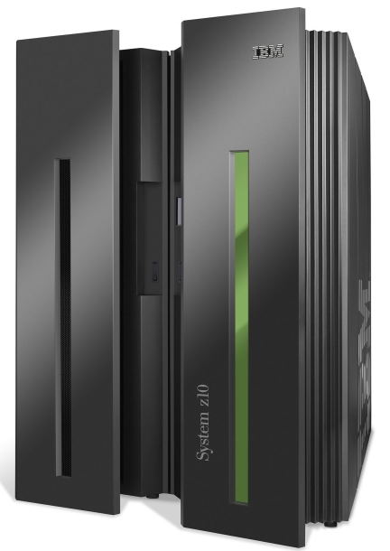
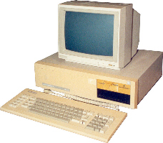
Analogy: mainframe to PC evolution*
App
App
App
App
App
App
App
App
App
App
App
Specialized
Applications
Open Interface
Specialized
Operating
System
Windows
(OS)
Linux
Mac
OS
or
or
Specialized
Hardware
Open Interface
Microprocessor
Vertically integrated
Closed, proprietary
Slow innovation
Small industry
Horizontal
Open interfaces
Rapid innovation
Huge industry
* Slide courtesy: N. McKeown

Slide 8

Traffic engineering: difficult traditional routing
5
3
v
w
5
2
u
2
1
z
3
1
2
x
y
1
Q: what if network operator wants u-to-z traffic to flow along uvwz, x-to-z traffic to flow xwyz?
A: need to define link weights so traffic routing algorithm computes routes accordingly (or need a new routing algorithm)!
Link weights are only control “knobs”: wrong!
Notes:
Note: implicit assumption here: destination based forwarding

Slide 9
Traffic engineering: difficult
5
3
v
w
5
2
u
2
1
z
3
1
2
x
y
1
Q: what if network operator wants to split u-to-z traffic along uvwz and uxyz (load balancing)?
A: can’t do it (or need a new routing algorithm)
Notes:
Note: implicit assumption here: destination based forwarding

Slide 10
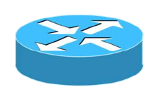
Traffic engineering: difficult
Networking 401
5
v
3
w
2
v
w
5
u
2
1
z
3
z
1
2
x
y
x
1
y
Q: what if w wants to route blue and red traffic differently?
A: can’t do it (with destination based forwarding, and LS, DV routing)
Notes:
Note: implicit assumption here: destination based forwarding

Slide 11
Software defined networking (SDN)
4. programmable control applications
…
3. control plane functions external to data-plane switches
routing
access control
load
balance
Remote Controller
control
plane
data
plane
CA
2. control, data plane separation
CA
CA
CA
CA
1: generalized“ flow-based” forwarding (e.g., OpenFlow)

Slide 12
SDN perspective: data plane switches
Data plane switches
fast, simple, commodity switches implementing generalized data-plane forwarding (Section 4.4) in hardware
switch flow table computed, installed by controller
API for table-based switch control (e.g., OpenFlow)
defines what is controllable and what is not
protocol for communicating with controller (e.g., OpenFlow)
network-control applications
…
routing
access
control
load
balance
control
plane
northbound API
SDN Controller
(network operating system)
southbound API
data
plane
SDN-controlled switches

Slide 13
SDN perspective: SDN controller
SDN controller (network OS):
maintain network state information
interacts with network control applications “above” via northbound API
interacts with network switches “below” via southbound API
implemented as distributed system for performance, scalability, fault-tolerance, robustness
network-control applications
…
routing
access
control
load
balance
control
plane
northbound API
SDN Controller
(network operating system)
southbound API
data
plane
SDN-controlled switches

Slide 14
SDN perspective: control applications
network-control apps:
“brains” of control: implement control functions using lower-level services, API provided by SND controller
unbundled: can be provided by 3rd party: distinct from routing vendor, or SDN controller
network-control applications
…
routing
access
control
load
balance
control
plane
northbound API
SDN Controller
(network operating system)
southbound API
data
plane
SDN-controlled switches

Slide 15
Components of SDN controller
routing
access
control
load
balance
Interface layer to network control apps: abstractions API
Interface, abstractions for network control apps
…
network graph
RESTful
API
intent
Network-wide state management layer: state of networks links, switches, services: a distributed database
…
statistics
flow tables
SDN
controller
Network-wide distributed, robust state management
…
Link-state info
host info
switch info
…
communication layer: communicate between SDN controller and controlled switches
OpenFlow
SNMP
Communication to/from controlled devices

Slide 16

OpenFlow protocol
operates between controller, switch
TCP used to exchange messages
optional encryption
three classes of OpenFlow messages:
controller-to-switch
asynchronous (switch to controller)
symmetric (misc)
OpenFlow Controller

Slide 17
OpenFlow: controller-to-switch messages
Key controller-to-switch messages
features: controller queries switch features, switch replies
configure: controller queries/sets switch configuration parameters
modify-state: add, delete, modify flow entries in the OpenFlow tables
packet-out: controller can send this packet out of specific switch port
OpenFlow Controller

Slide 18
OpenFlow: switch-to-controller messages
Key switch-to-controller messages
packet-in: transfer packet (and its control) to controller. See packet-out message from controller
flow-removed: flow table entry deleted at switch
port status: inform controller of a change on a port.
OpenFlow Controller
Fortunately, network operators don’t “program” switches by creating/sending OpenFlow messages directly. Instead use higher-level abstraction at controller

Slide 19
SDN: control/data plane interaction example
Dijkstra’s link-state
Routing
1
S1, experiencing link failure using OpenFlow port status message to notify controller
4
5
…
network graph
RESTful
API
intent
2
SDN controller receives OpenFlow message, updates link status info
3
…
statistics
flow tables
…
3
Dijkstra’s routing algorithm application has previously registered to be called when ever link status changes. It is called.
Link-state info
host info
switch info
2
…
OpenFlow
SNMP
6
4
Dijkstra’s routing algorithm access network graph info, link state info in controller, computes new routes
1
s2
s1
s4
s3

Slide 20
SDN: control/data plane interaction example
Dijkstra’s link-state
Routing
4
5
…
network graph
RESTful
API
intent
5
link state routing app interacts with flow-table-computation component in SDN controller, which computes new flow tables needed
3
…
statistics
flow tables
…
Link-state info
host info
switch info
2
…
6
Controller uses OpenFlow to install new tables in switches that need updating
OpenFlow
SNMP
6
1
s2
s1
s4
s3

Slide 21
OpenDaylight (ODL) controller
…
Traffic
Engineering
ODL Lithium controller
network apps may be contained within, or be external to SDN controller
Service Abstraction Layer: interconnects internal, external applications and services
REST API
Network service apps
Basic Network Service Functions
topology
manager
switch
manager
stats
manager
Access
Control
forwarding
manager
host
manager
Service Abstraction Layer (SAL)
…
OpenFlow 1.0
SNMP
OVSDB

Slide 22
ONOS controller
…
Network
control apps
control apps separate from controller
intent framework: high-level specification of service: what rather than how
considerable emphasis on distributed core: service reliability, replication performance scaling
northbound abstractions,
protocols
REST API
Intent
hosts
paths
flow rules
topology
ONOS
distributed core
devices
links
statistics
device
link
host
flow
packet
southbound abstractions,
protocols
OpenFlow
Netconf
OVSDB

Slide 23
SDN: selected challenges
hardening the control plane: dependable, reliable, performance-scalable, secure distributed system
robustness to failures: leverage strong theory of reliable distributed system for control plane
dependability, security: “baked in” from day one?
networks, protocols meeting mission-specific requirements
e.g., real-time, ultra-reliable, ultra-secure
Internet-scaling

Slide 24
What is network management?
autonomous systems (aka “network”): 1000s of interacting hardware/software components
other complex systems requiring monitoring, control:
jet airplane
nuclear power plant
others?
"Network management includes the deployment, integration
and coordination of the hardware, software, and human
elements to monitor, test, poll, configure, analyze, evaluate,
and control the network and element resources to meet the
real-time, operational performance, and Quality of Service
requirements at a reasonable cost."

Slide 25


Infrastructure for network management
definitions:
managing entity
agent
data
managing
entity
managed devices contain managed objects whose data is gathered into a Management Information Base (MIB)
data
managed device
network
management
protocol
agent
data
managed device
agent
data
managed device
agent
data
agent
data
managed device
managed device

Slide 26
SNMP protocol
Two ways to convey MIB info, commands:
managing
entity
managing
entity
request
trap msg
response
agent
data
agent
data
managed device
managed device
request/response mode
trap mode

Slide 27
SNMP protocol: message types
Message type
Function
GetRequest
GetNextRequest
GetBulkRequest
manager-to-agent: “get me data”
(data instance, next data in list, block of data)
InformRequest
manager-to-manager: here’s MIB value
SetRequest
manager-to-agent: set MIB value
Response
Agent-to-manager: value, response to
Request
Trap
Agent-to-manager: inform manager
of exceptional event

Slide 28
SNMP protocol: message formats
Get/set header
Variables to get/set
PDU
type
(0-3)
Error
Status
(0-5)
Request
ID
Error
Index
Name
Value
Name
Value
….
PDU
type
4
Trap
Type
(0-7)
Enterprise
Agent
Addr
Specific
code
Time
stamp
Name
Value
….
Trap header
Trap info
SNMP PDU
More on network management: see earlier editions of text!

Slide 29
Review of all the topics
we’ve learned a lot!
Issues in the data plane –
approaches to network control plane
per-router control (traditional)
logically centralized control (software defined networking)
traditional routing algorithms
implementation in Internet: OSPF, BGP
SDN controllers
implementation in practice: ODL, ONOS
Internet Control Message Protocol
network management
next stop: link layer!

